Slide 1


Social Buzz Soars: IPO Mastery and Big Data Brilliance Partnership

Slide 2


Today's agenda
Project recap
Problem
The Analytics team
Process
Insights
Summary

Slide 3

Guiding Social Buzz, a leading social media and content creation platform, through a 3-month strategic engagement focused on IPO readiness and optimization of big data practices.
An audit of their big data practice
Recommendations for a successful IPO
An analysis of their content categories that highlights the top 5 categories with the largest aggregate popularity
Project Recap

Slide 4

Problem
1. IPO Preparedness:
- Social Buzz aims for an IPO by next year.
- Lack of internal resources for a smooth transition to the public market.
2. Scaling Challenges:
- Rapid growth to 500 million monthly users.
- Inadequate resources to manage the current scale effectively.
3. Big Data Complexity:
- Over 100,000 daily unstructured pieces of content.
- Need for sophisticated technology to analyze and manage data.
4. External Expertise Needed:
- Limited experience in leveraging third-party firms.
- Seeking guidance on IPO execution and best practices in big data management.
An analysis of their content categories that highlights the top 5 categories with the largest aggregate popularity

Slide 5
Process
1
Data Understanding
2
Data Cleaning
3
Data Modelling
4
Data Analysis
5
Data Visualizations and Uncovering Insights

Slide 6
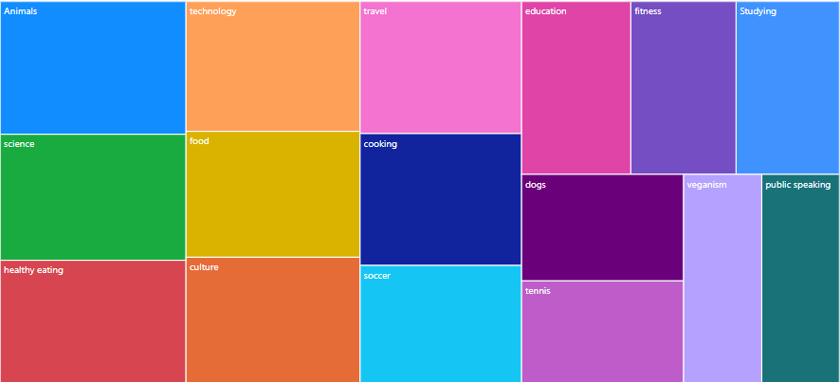
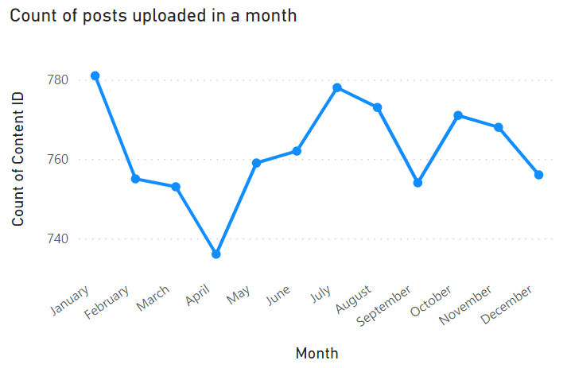
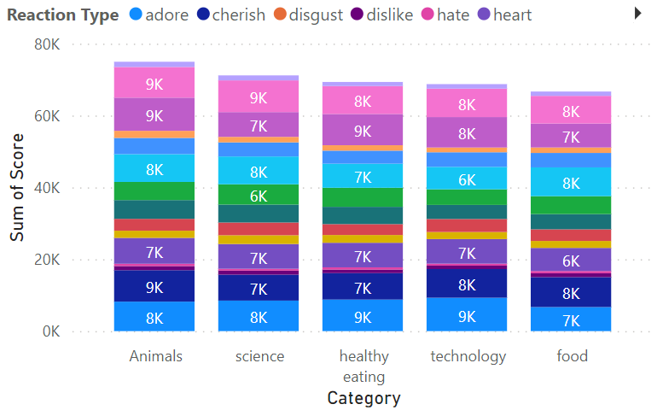

Insights
There are 16 unique categories which this dataset holds.
January was the month where the count was at peak.
Technology in reaction type made up 2.65% of sum of score.

Slide 7
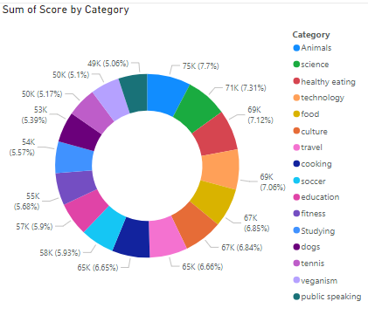

Slide 8
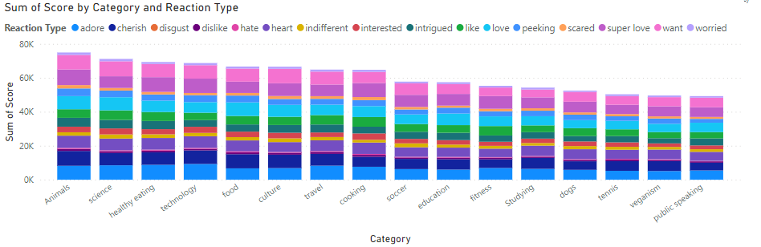

Slide 9
There are 16 unique categories which this dataset holds.
The top 5 performing categories with the largest aggregate popularity are:
Animals
Science
Healthy Eating
Technology
Food
Summary
January was the month where the count was at peak.
Technology in reaction type made up 2.65% of sum of score.

Slide 10
Thank you!
ANY QUESTIONS?

